Slide 1

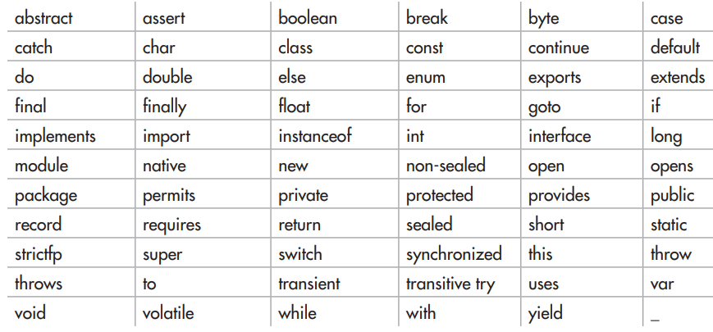
Java Fundamentals
Two Control Statements:
The if Statement and the for loop same as C.

Slide 2

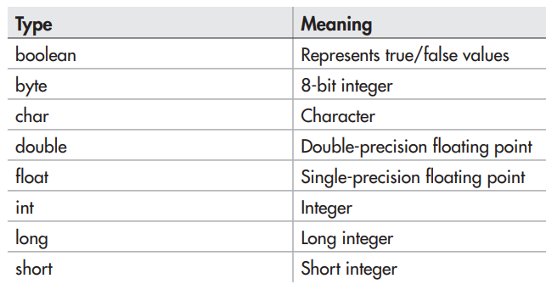
Introducing Data Types and Operators

Slide 3
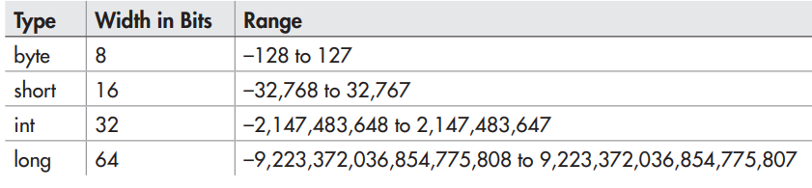
Introducing Data Types and Operators

Slide 4

Introducing Data Types and Operators
The boolean type represents true/false values.
Java defines the values true and false using the reserved words true and false.
Thus, a variable or expression of type boolean will be one of these two values.

Slide 5
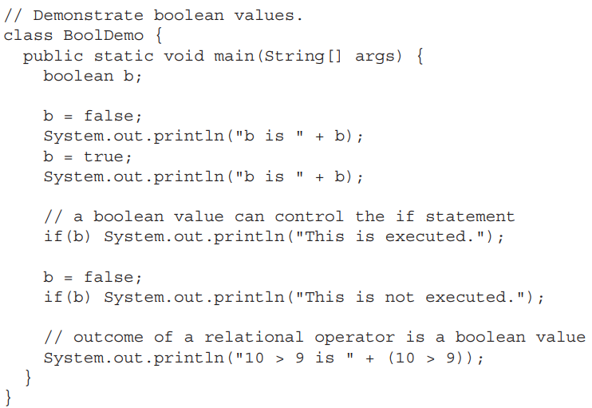
Introducing Data Types and Operators

Slide 6
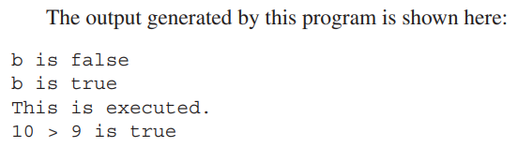
Introducing Data Types and Operators

Slide 7


Introducing Data Types and Operators
Literals refer to fixed values that are represented in their human readable form.
For example,
A hexadecimal literal must begin with 0x or 0X (a zero followed by an x or X). An octal literal begins with a zero. Here are some examples:

Slide 8

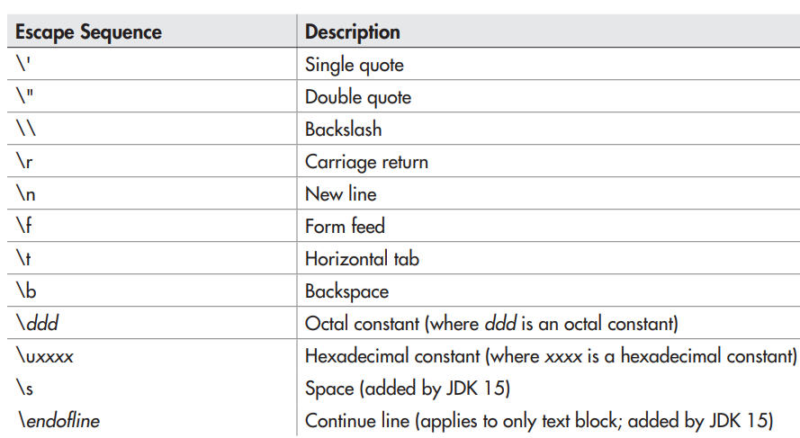
Introducing Data Types and Operators

Slide 9

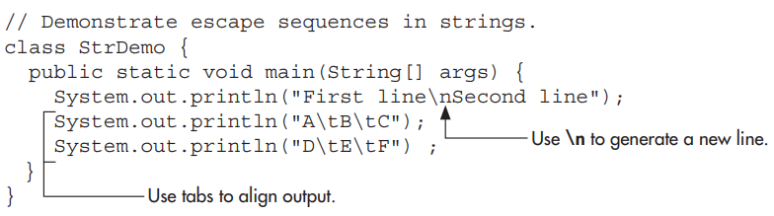
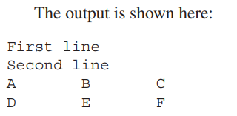
Introducing Data Types and Operators

Slide 10



Introducing Data Types and Operators

Slide 11

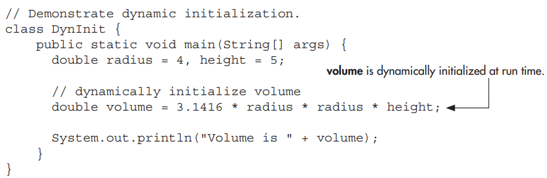
Introducing Data Types and Operators

Slide 12
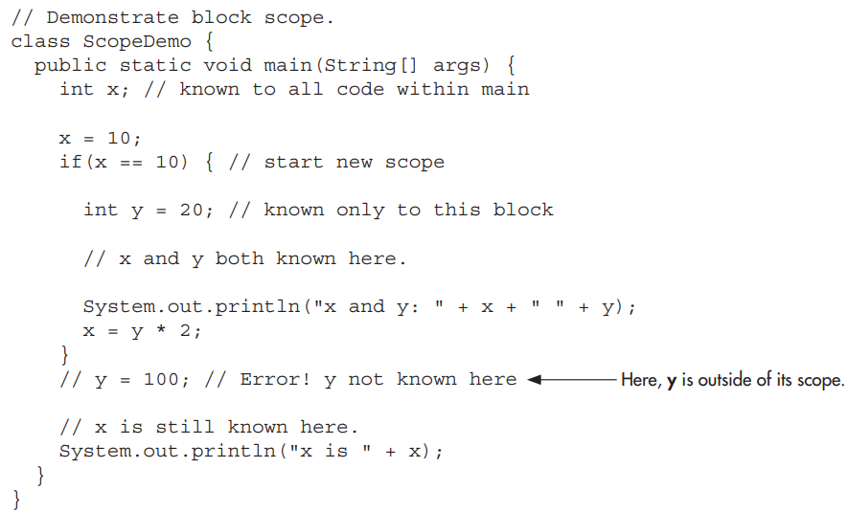
Introducing Data Types and Operators

Slide 13
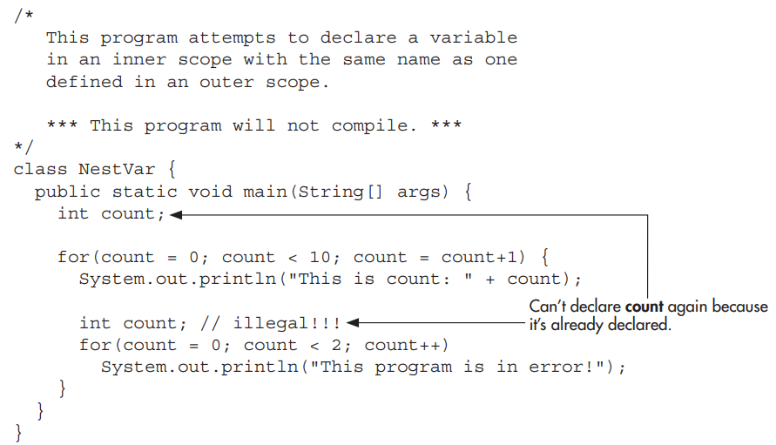
Introducing Data Types and Operators

Slide 14

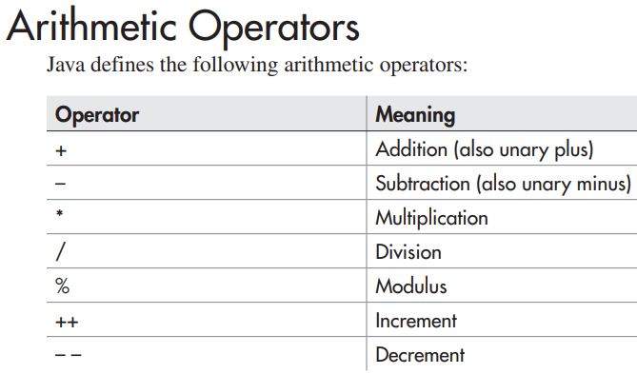
Introducing Data Types and Operators

Slide 15
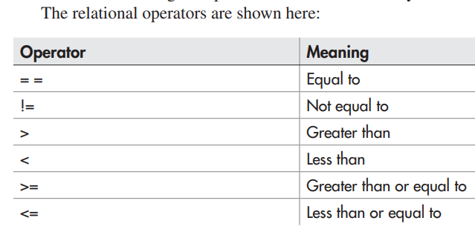
Introducing Data Types and Operators

Slide 16
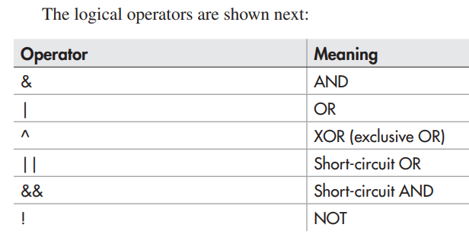
Introducing Data Types and Operators

Slide 17


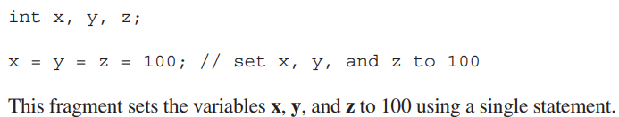
Introducing Data Types and Operators

Slide 18
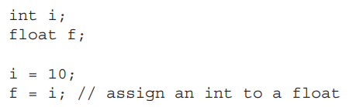
Introducing Data Types and Operators
In programming, it is common to assign one type of variable to another.
For example, you might want to assign an int value to a float variable, as shown here:

Slide 19
Introducing Data Types and Operators
When compatible types are mixed in an assignment, the value of the right side is automatically converted to the type of the left side.
However, because of Java’s strict type checking, not all types are compatible, and thus, not all type conversions are implicitly allowed.
For example, boolean and int are not compatible.

Slide 20

Introducing Data Types and Operators
When one type of data is assigned to another type of variable, an automatic type conversion will take place if

Slide 21

Introducing Data Types and Operators
Although the automatic type conversions are helpful, they will not fulfill all programming needs because they apply only to widening conversions between compatible types.
For all other cases you must employ a cast.
A cast is an instruction to the compiler to convert one type into another. Thus, it requests an explicit type conversion.

Slide 22


Introducing Data Types and Operators
A cast has this general form:

Slide 23
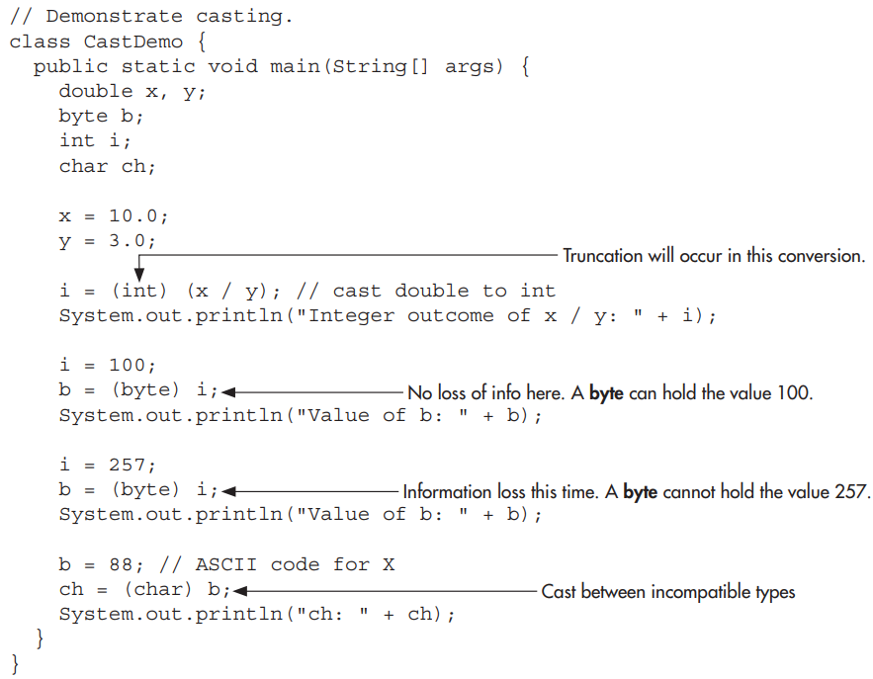
Introducing Data Types and Operators

Slide 24
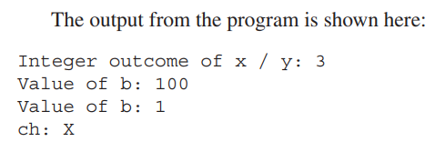
Introducing Data Types and Operators

Slide 25

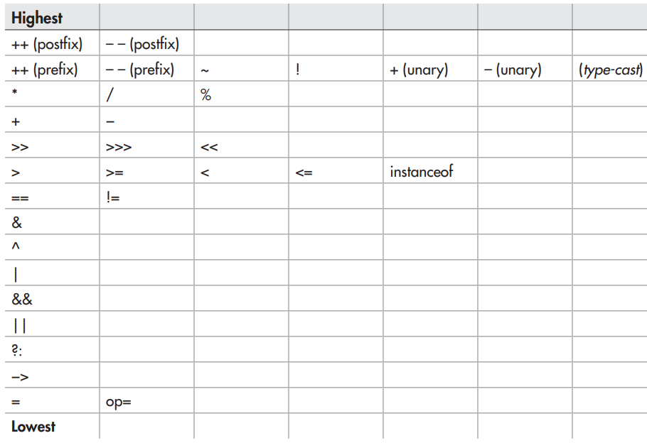
Introducing Data Types and Operators

Slide 26
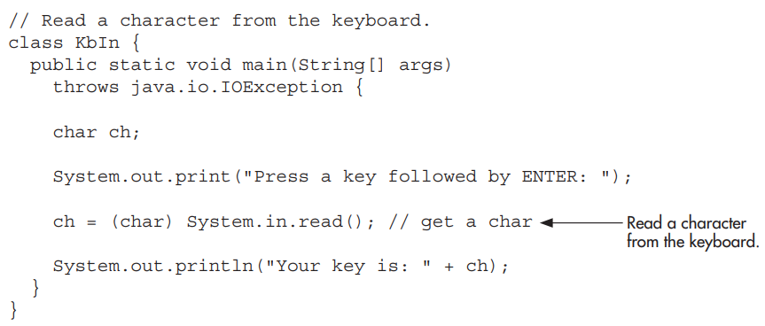
Program Control Statements

Slide 27





Program Control Statements
Home work …..

Slide 28

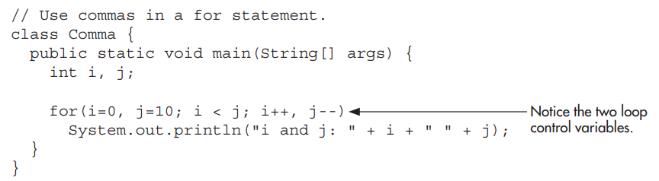
Program Control Statements

Slide 29

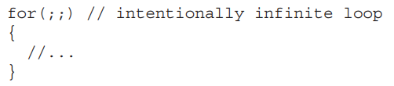


Program Control Statements

Slide 30

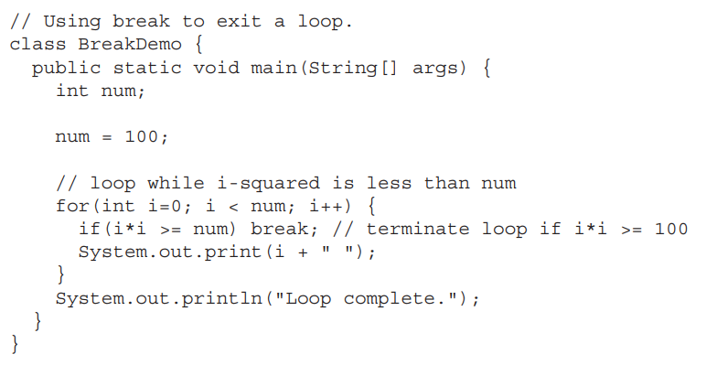
Program Control Statements

Slide 31

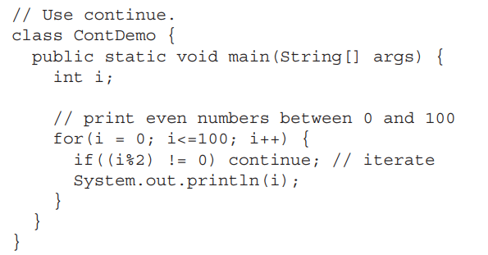
Program Control Statements

